Slide 1
Origins of Data, Computing Lines, Curves, and Numbers
Dr. Charles R. Severance
www.ca4e.com
online.dr-chuck.com

Slide 2
Outline
Measuring the Solar System
Stonehenge / Sun Dial
Continuous physical analog computing
Ankithera / Planet Mobile / Slide Rule / Pilot E6B
Digital physical devices
Pen / Clocks / Adders / Multipliers
CRC Standard Mathematical Tables
More complex mathematical functions without calculator
Iteration
"Human Computers" / Babbage Difference Engine
Electromechanical Computers
Bombe / Pinball Machine
Electronic Computers – Tubes
Colossus

Slide 3
Computing and Mathematics
This is not a math class and there is no math pre-requisite
In my C class I talk about how everything changed in 1978 (roughly)
Before 1978
Much of computing was computations – numbers were the focus
No Internet
Computers were large – filled a room
After 1978
Much of computing is information
Internet - people communicating to other people through text
Computers kept getting smaller and faster
The arc of computers and computing starts with numbers

Slide 4
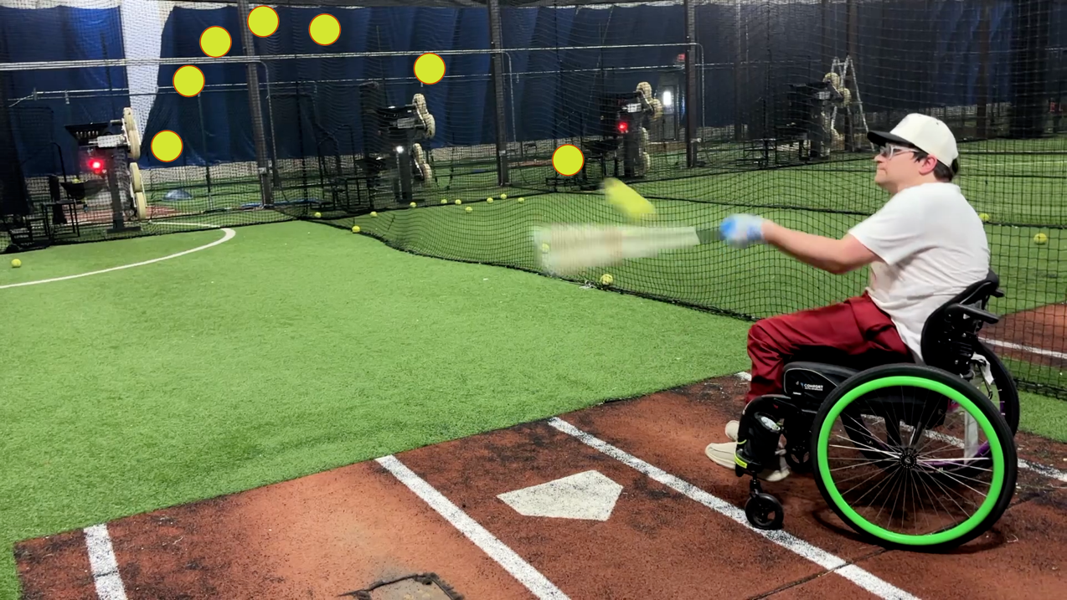
Our eyes "see" objects in a straight line from our eye to the object. But in nature, any moving object is moving along a curve. Predicting the path of a moving object requires a lot of measuring, analysis, and mathematics. Our brains understand (or have been programmed to understand) curved motion implicitly. Predicting the path of a moving object in three dimensions is necessary for us to survive (or play sports)
Photo Courtesy of @WarWheelz

Slide 5
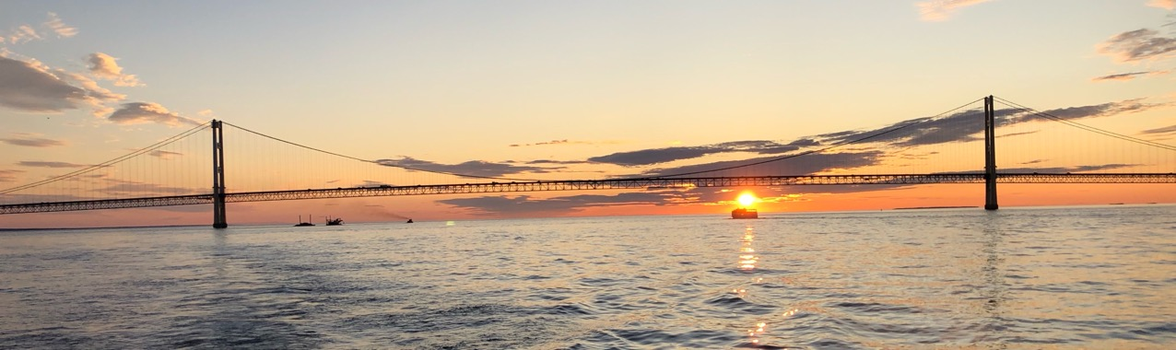
Astronomy – Star Gazing
Amateur scientists from the beginning of human consciousness have gazed at the Sun, Moon, Planets, and Stars and tried to gain insight
December
March
June
August
December
September
June

Slide 6
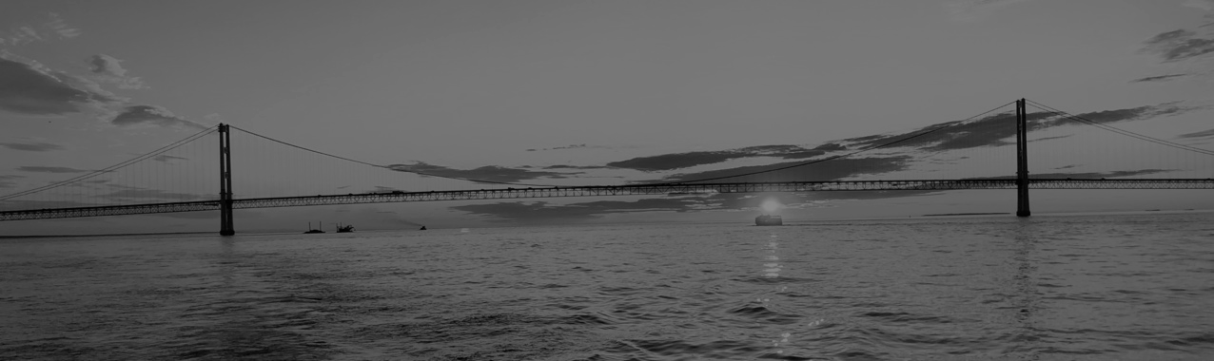

Astronomy – Star Gazing
Amateur scientists from the beginning of human consciousness have gazed at the Sun, Moon, Planets, and Stars and tried to gain insight
December
March
June
November
December
September
June

Slide 7
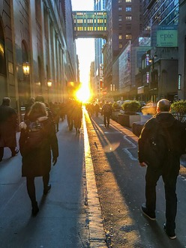
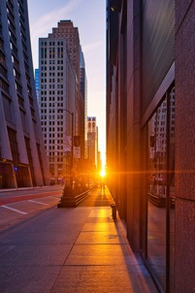
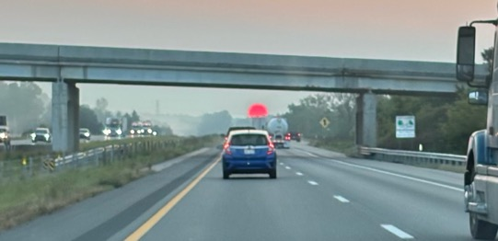
Stonehenge – 4500 Years Ago (YA)
AI: Ancient artifacts to measure the Sun around the world
Göbekli Tepe, Turkey Lunar / Solar Calendar (?) – 12000YA
Egypt Sun dials invented 3500 years ago (YA)
China sun dials over 3000 YA
Mexico The Descent of Kukulkán – 1200 YA
Temple of Petra 1000 YA
India Sun Temple, Konark – 750 YA
Modern Henges
Manhattan Henge 2020-01
Chicago henge 2022-03
Dr. Chuck's commute henge 2024-09
Photos from Wikipedia.

Slide 8
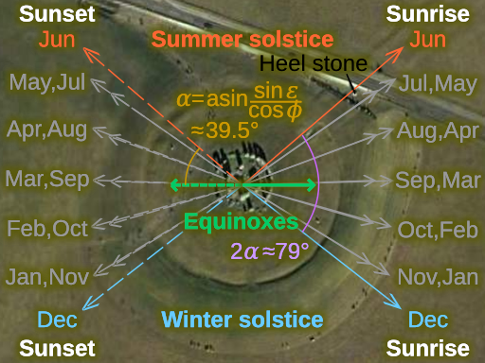
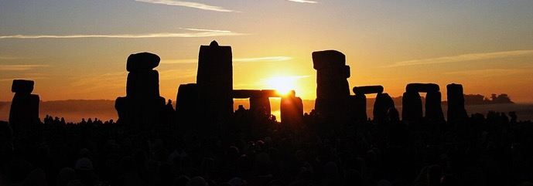
Stonehenge: Sunrise and sunset tracking
Stonehenge had several versions and was built iteratively from 5100 YA to 3600 YA (Years ago)
By the time the latest structure was built, the earlier structures measured the angle of sunrise and sunset throughout the year
You can think of it as a sun tracking data table calibrated over 2500 years

Slide 9
Continuous / Analog Computing

Slide 10
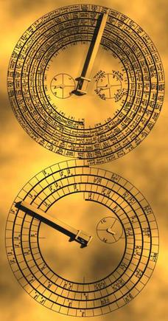
Physical Devices - Printed Scales
"Continuous" means that these devices have knobs, gears or sliders that use physical movement to accurately approximate a computation
A key to these devices is intricate and accurate printed scale
Data is input into the devices by moving an indicator to a point on a scale and then moving something else and reading an answer from an indicator and scale.
Wikipedia

Slide 11
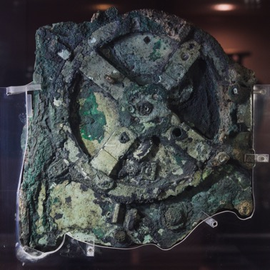

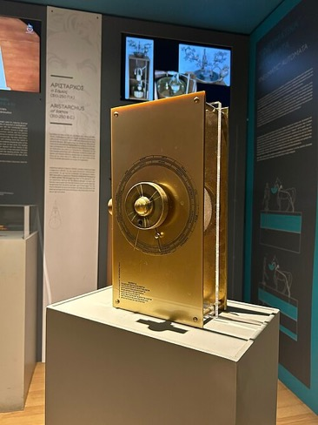
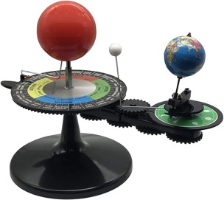
Antikythera mechanism – 2100 YA
Oldest known continuous analogue computer
Uses gears to model the known solar system
Sun, Moon, Earth, Mercury, Venus, Mars, Jupiter, Saturn
Models more complex Sun-Moon-Earth 19, 76 and 223 year cycles
Indiana Jones and The Dial of Destiny
You can buy one on Amazon
AI: Antikythera like mechanisms in cultures around the world

Slide 12
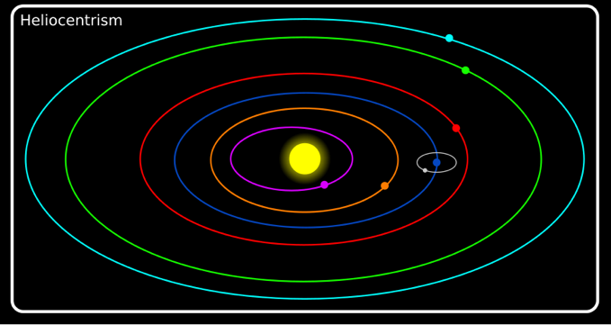
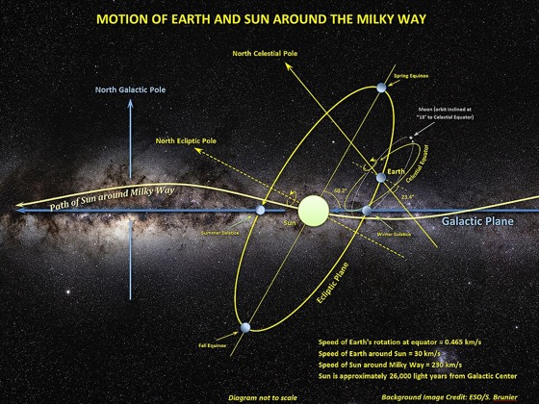
Reflections on Solar System Models
www.ca4e.com/ref
We have been taught a simple model of the solar system called "heliocentrism" conceived by Nicolaus Copernicus in 1543
But the planets orbits are at different angles and the sun is also moving
As the Sun moves through the Milky Way, Earth and the other planets follow along — so our orbits trace helical paths through space.
AI: Actual motion of earth through the milky way galaxy
AI: Nicolaus Copernicus gets in trouble
Notes:
www.youtube.com/watch?v=fJuaPyQFrYk

Slide 13
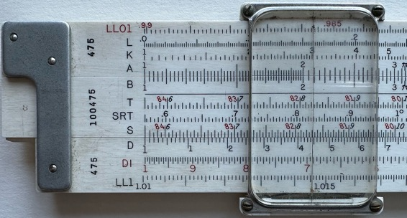
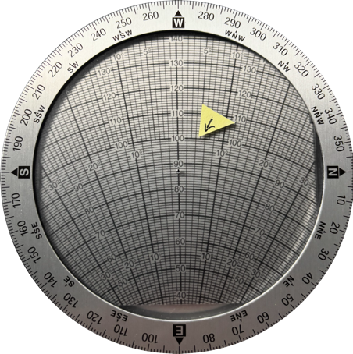
Modern Continuous Analog Computing Devices
Slide Rule – Multiplication using addition and logarithms
E6B wind calculator for airplane pilots that uses a circular calculator to do trigonometry and Pythagorean theorem computations
Ignore the math details ☺
https://commons.wikimedia.org/wiki/File:Slide_rule_scales_front.jpg

Slide 14
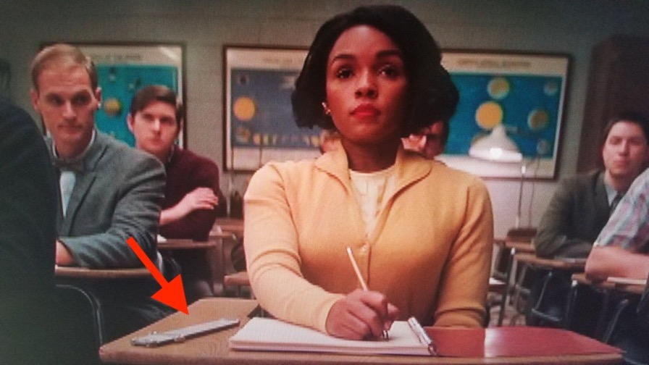

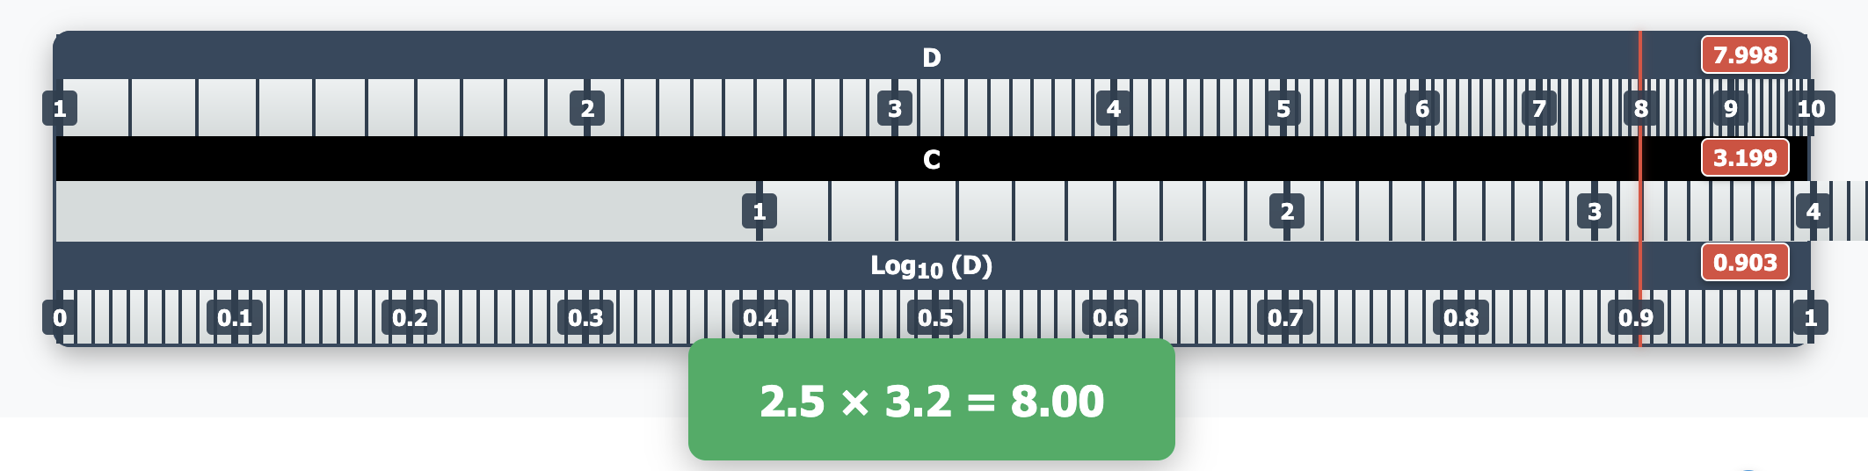
Slide Rule
www.ca4e.com/ref
Screen shot from Hidden Figures movie
https://commons.wikimedia.org/wiki/File:Slide_rule_scales_front.jpg

Slide 15
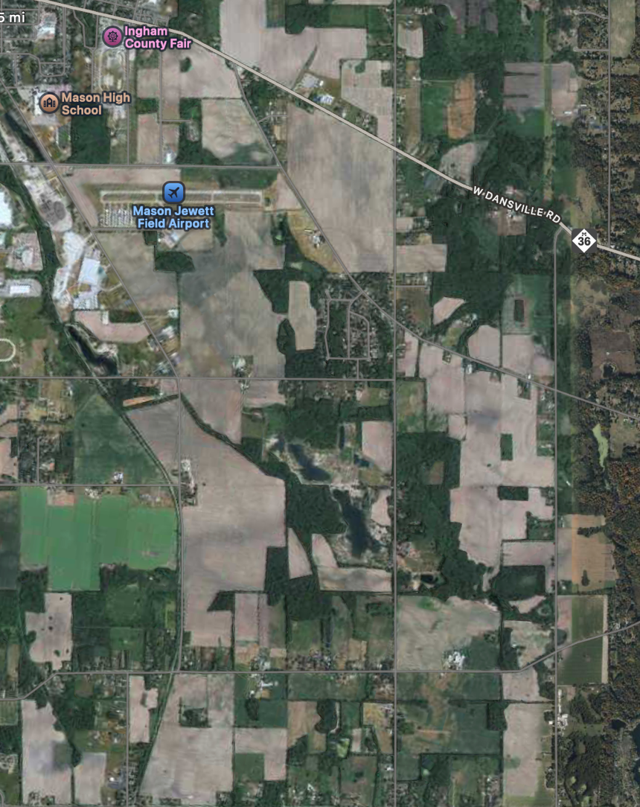
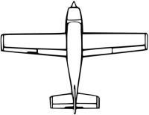
Computing Wind Correction for Airplanes (drift angle)
Our airplane goes 100 knots air speed and we want to go west (270 degrees)
The wind is out of the northwest (300 degrees) at 15 knots
If we fly straight west, the wind will both slow us down and push us south
Where should we point the plane to actually have a ground track that is west and what is our effective ground speed?

Slide 16
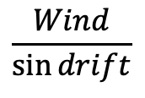
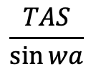
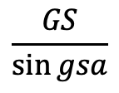
Use Law of Sines!
wa
WIND
www.ca4e.com/ref
WIND
WIND
gsa
wa
gsa
gsa
wa
GS
GS
TAS
GS
TAS
TAS
$$\frac{TAS}{\sin{wa}}$$
=
$$\frac{Wind}{\sin{drift}}$$
=
$$\frac{GS}{\sin{gsa}}$$
drift
drift
drift
# Python:
drift = math.degrees(math.asin(math.sin(math.radians(wa)) / tas * wind))
gsa = 180 - ((wa % 180) + drift)
gs = math.fabs((wind * math.sin(math.radians(gsa))) / math.sin(math.radians(drift)))

Slide 17
To *actually* go west…
Our airplane goes 100 knots and we want to go west (270 degrees)
The wind is out of the northwest (300 degrees) at 15 knots
We will fly a heading of 274.3 degrees and expect a ground speed (west) of 87 knots

Slide 18
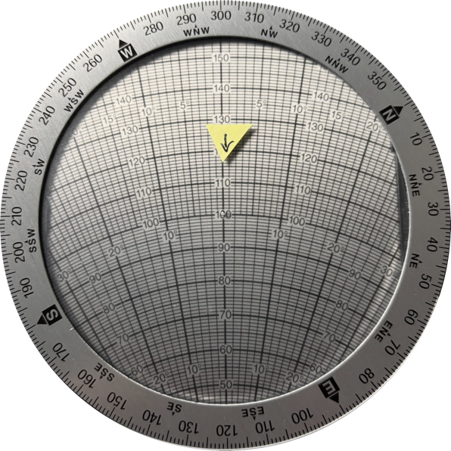

Pilots and Trigonometry?
Wind Direction
300 degrees
Wind Speed
15 knots
We have an analog computer called the E6B that does the entire calculation by rotating and sliding and reading numbers directly from the device
This is an analogue equivalent to the law of sines computation
Desired course 270 degrees
Air speed 100 Knots
Drift angle 4 degrees
Ground speed 87 knots

Slide 19
Put the wind in the E6B
Rotate the dial to the wind direction (300 degrees)
Move the speed slider to 100 knots
Add 15 knots and make a mark at 115 knots.

Slide 20
Apply the wind to the plane
Rotate to desired course of 270 degrees
Move the mark to the true air speed of the plane (100 knots)

Slide 21
Read the result of the calculation
Since the wind is mostly coming form the front, the ground speed will be about 87 knots
To compensate for the drift we need a "crab angle" of 4 degrees so we fly a heading of 274 degrees

Slide 22
The point is not to teach flying
A physical (analog) device can do "graphical calculations"
Sliding or rotating scales
Gears
Other things can compute
Water
Pulleys
Wikipedia

Slide 23
Physical Digital Devices

Slide 24
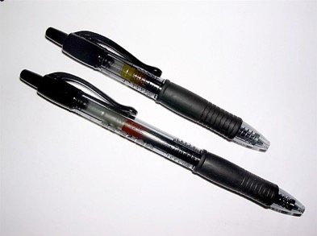
Physical devices that are digital
Physically built to have two stable states
On (1) or Off (0)
Require sufficient physical input to switch states – you often hear a click
If the input is not enough to change state they usually fall back to the previous stable state
Capturing the new state is often called "latching" – it sounds a bit like clicking
https://en.wikipedia.org/wiki/Retractable_pen

Slide 25
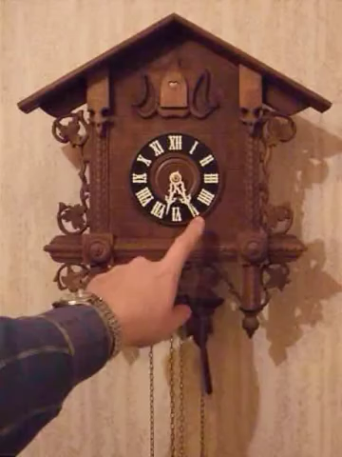
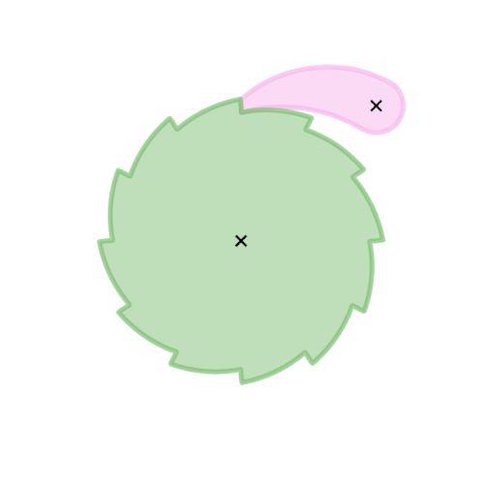
Clocks as Counters
Early clocks used a pendulum and a series of ratchets and gears that acted as counters for seconds, minutes, and hours
At particular times / counts they would run "programs" to make sounds to mark the passage of time
https://en.wikipedia.org/wiki/Ratchet_(device)
https://en.wikipedia.org/wiki/Cuckoo_clock

Slide 26
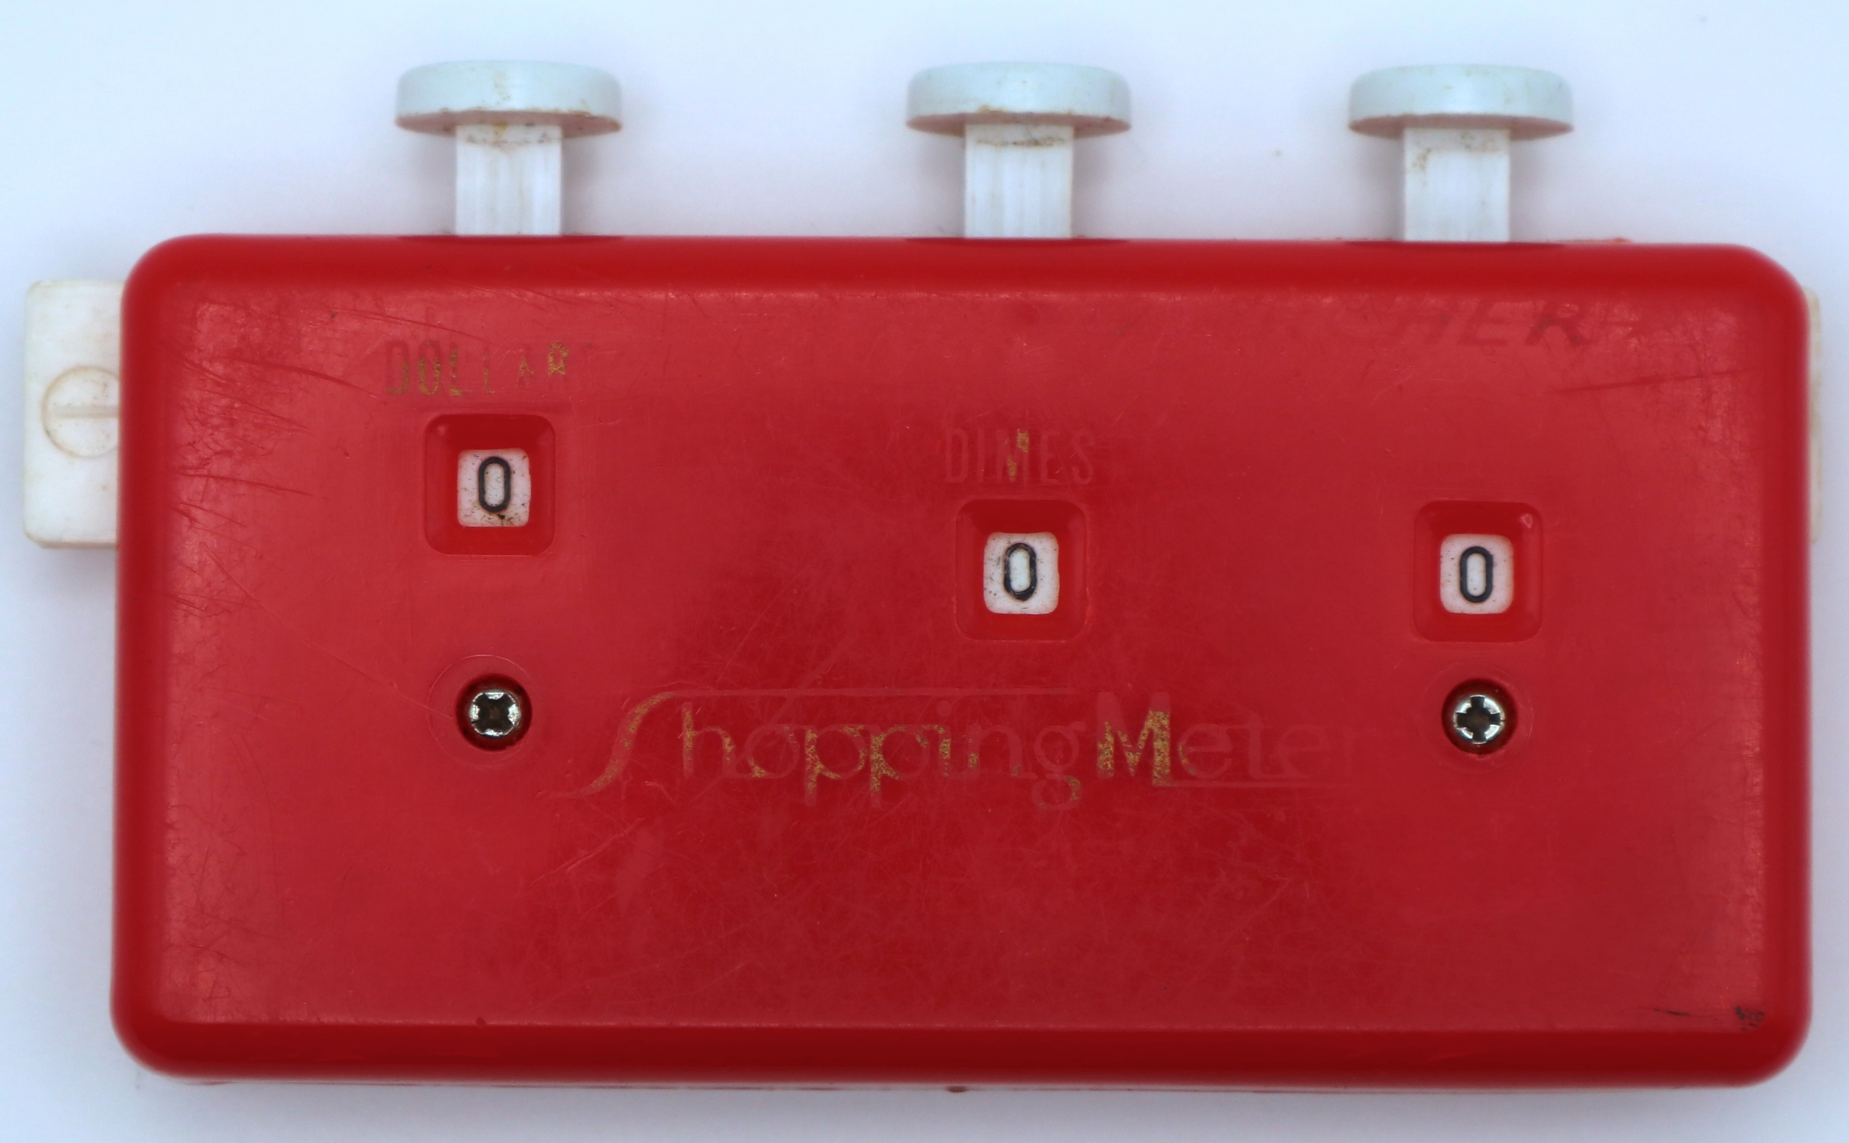
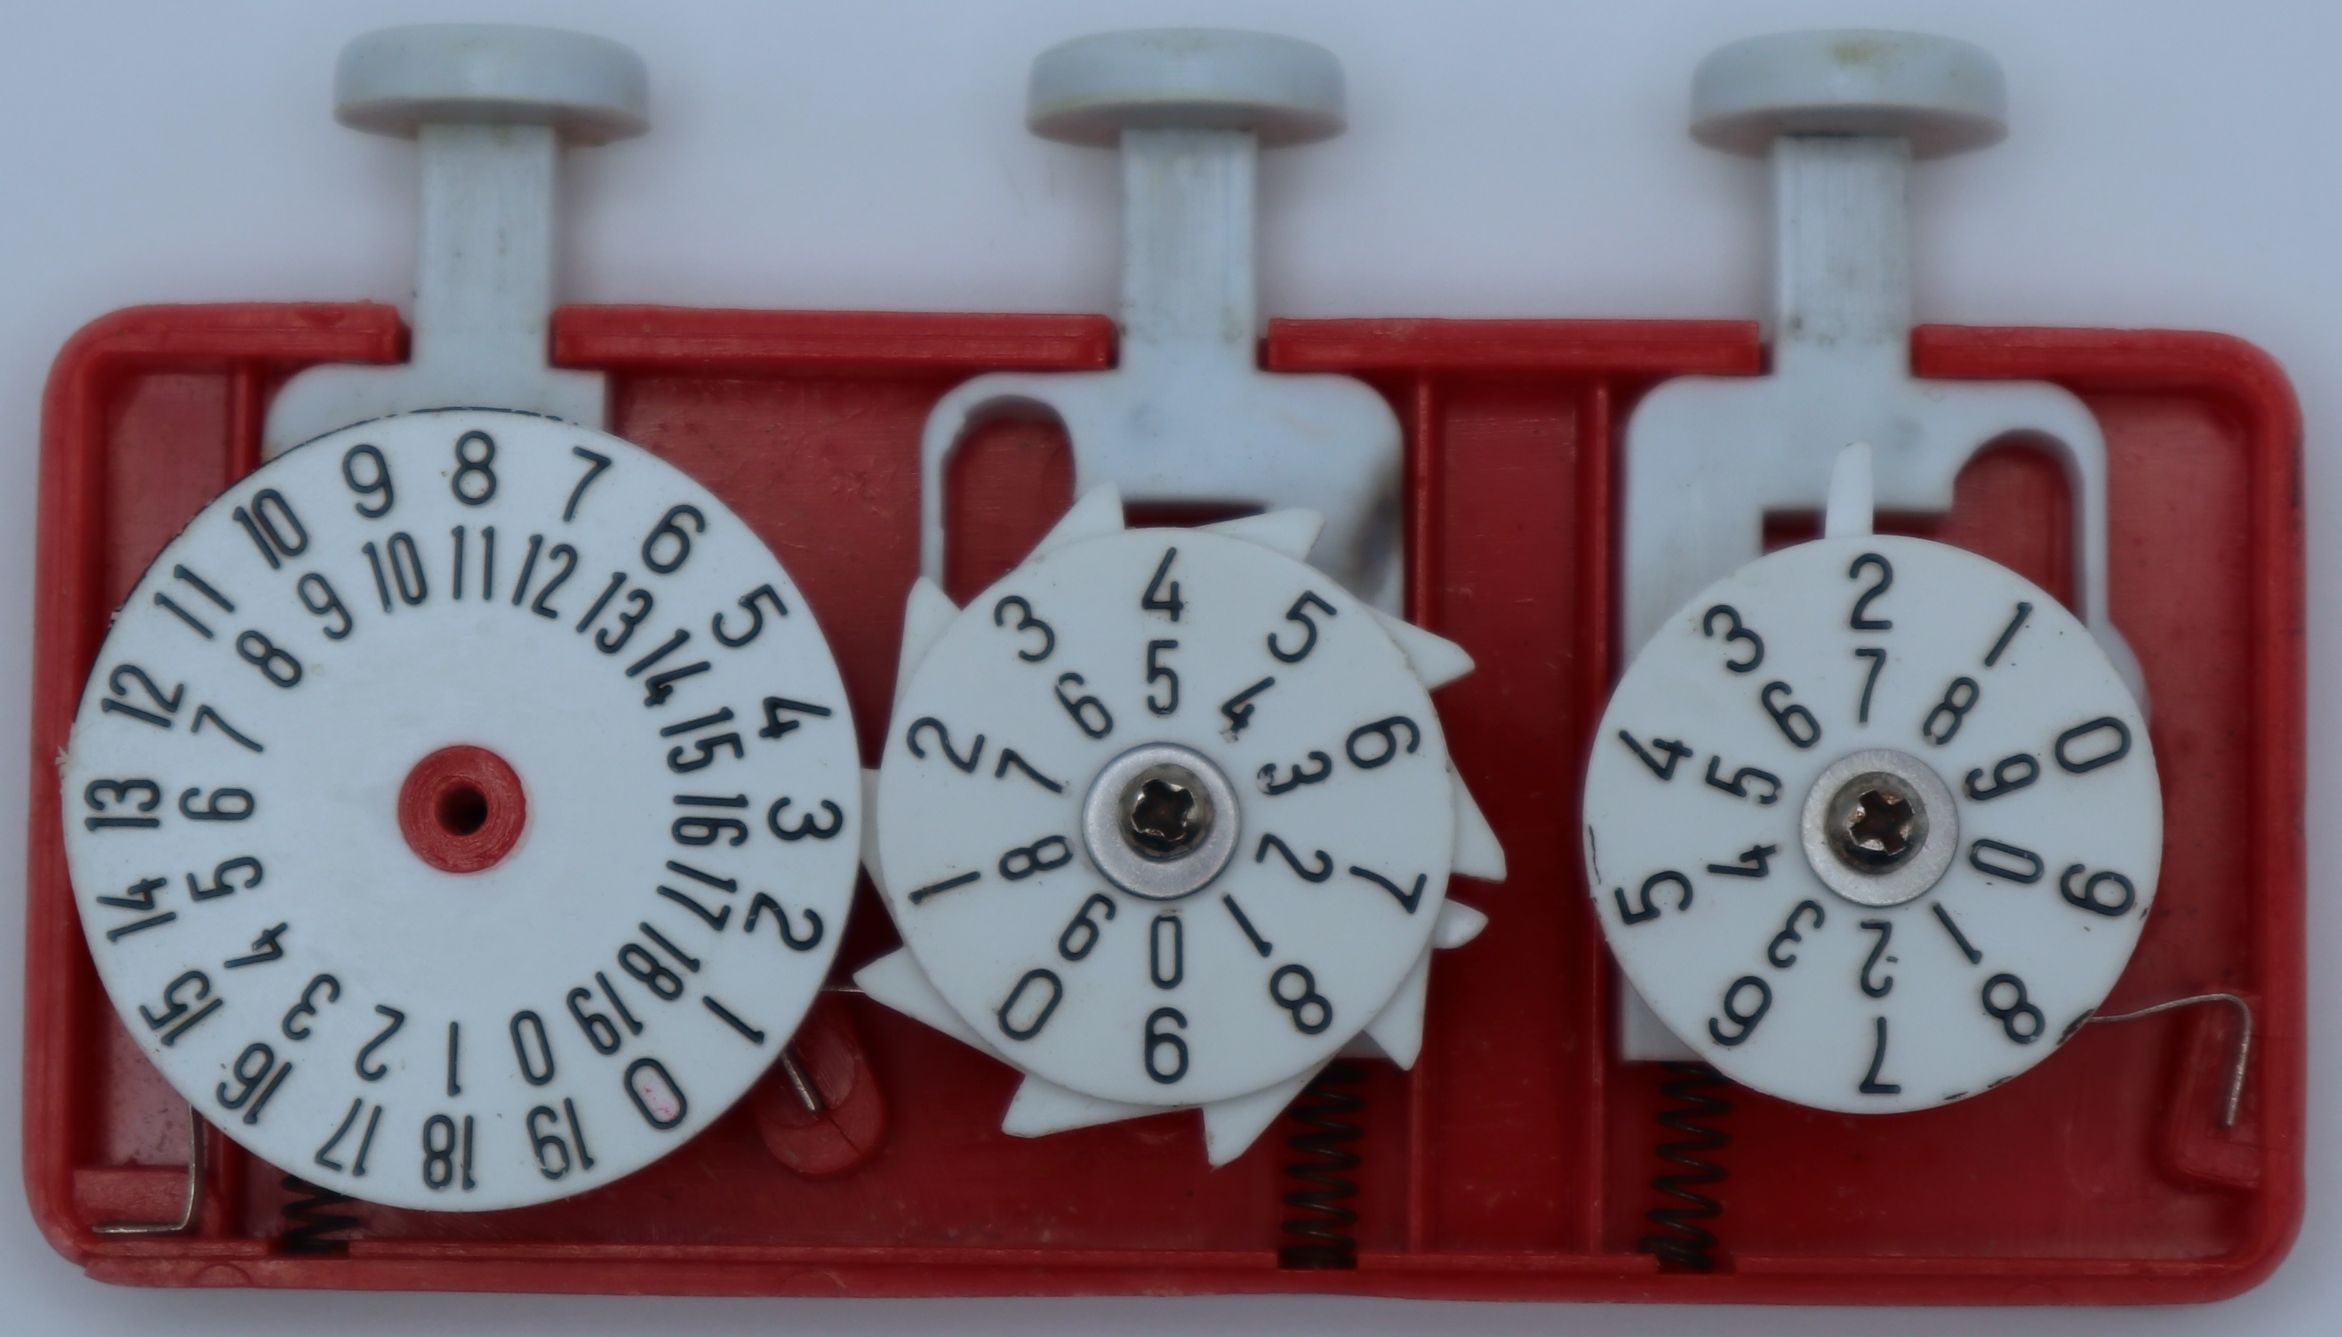
Counters with Carry Propagation
Numbers with multiple columns can be added if there is a carry mechanism that advances the next column when the current column overflows
Note that carrying into a column can cause overflow into the next column – so we call this "ripple carry" as it has the potential to ripple through several columns.

Slide 27
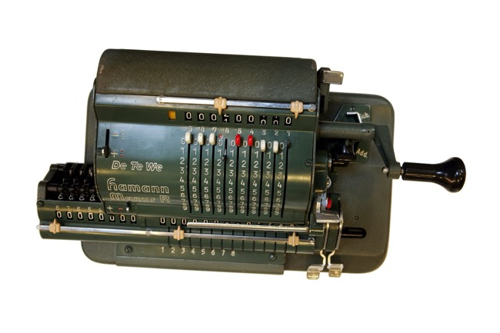
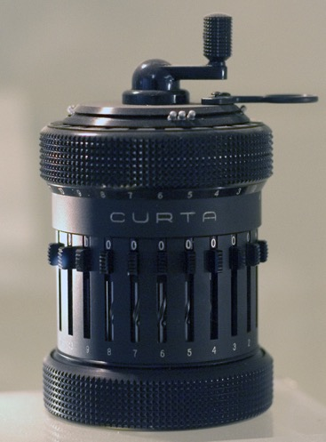
Iteration
With larger numbers and addition with carry as something that can work, the move is to "iterate"
Multiplication is repeated addition. If you have a way to count down from a number, you can add a motor or crank to automate multiplication.
https://en.wikipedia.org/wiki/Mechanical_computer

Slide 28
More Complex Math

Slide 29
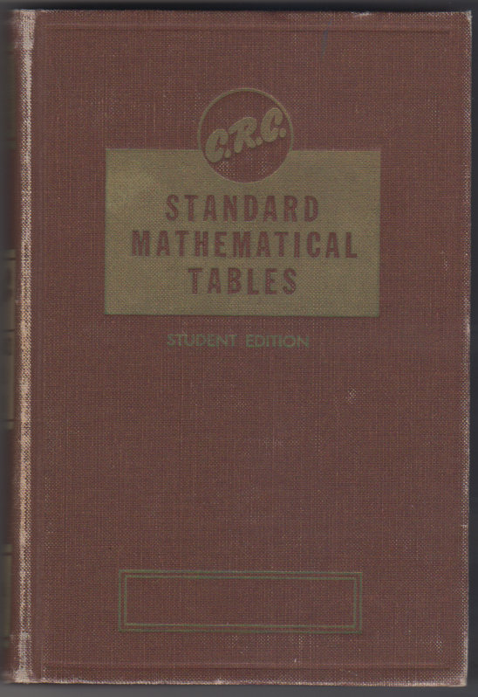
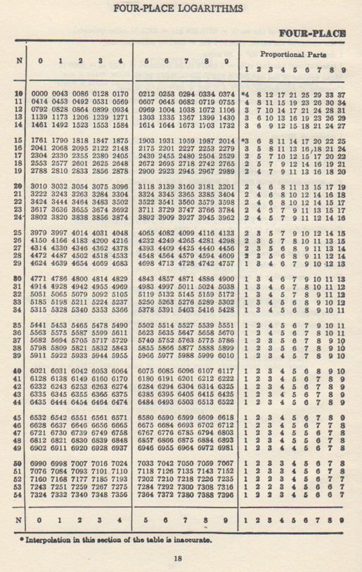
Before Scientific Calculators
For more complex math like trigonometry and logarithms we often used books with tables of numbers.

Slide 30
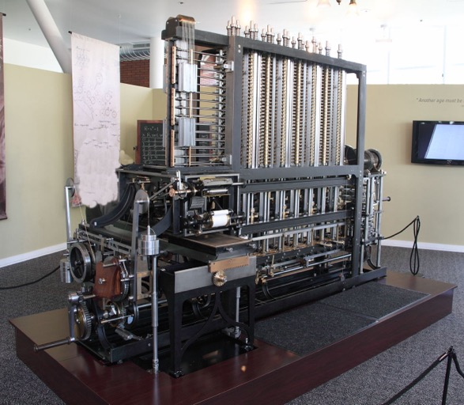
Babbage Difference Engine
www.ca4e.com/ref
In the 1820's Charles Babbage designed a mechanical calculator to compute up to seventh order polynomials
It could produce tables of advanced functions using polynomial approximation
Babbage built a small prototype in the 1800's but a full scale system was not built until 1991 – and it worked!
https://en.wikipedia.org/wiki/Difference_engine

Slide 31
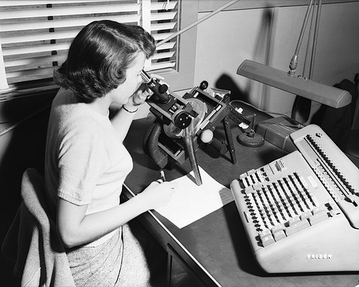

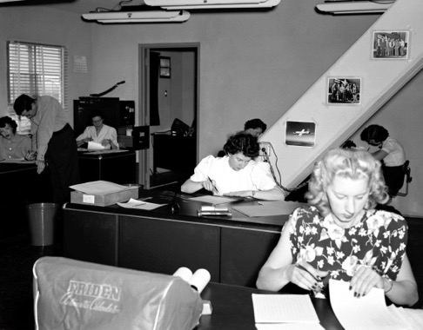
Human Computers
Until the advent of Scientific Calculators (sin, log, etc.) we depended on tables for complex functions
Often these tables were produced using "Computers" – people that used add/multiply machines to run long calculations to produce the tables
The movie "Hidden Figures" (2016) explores the shift from human to electronic computers
https://en.wikipedia.org/wiki/Computer_(occupation)
https://en.wikipedia.org/wiki/Hidden_Figures

Slide 32
Iteration / Loops

Slide 33

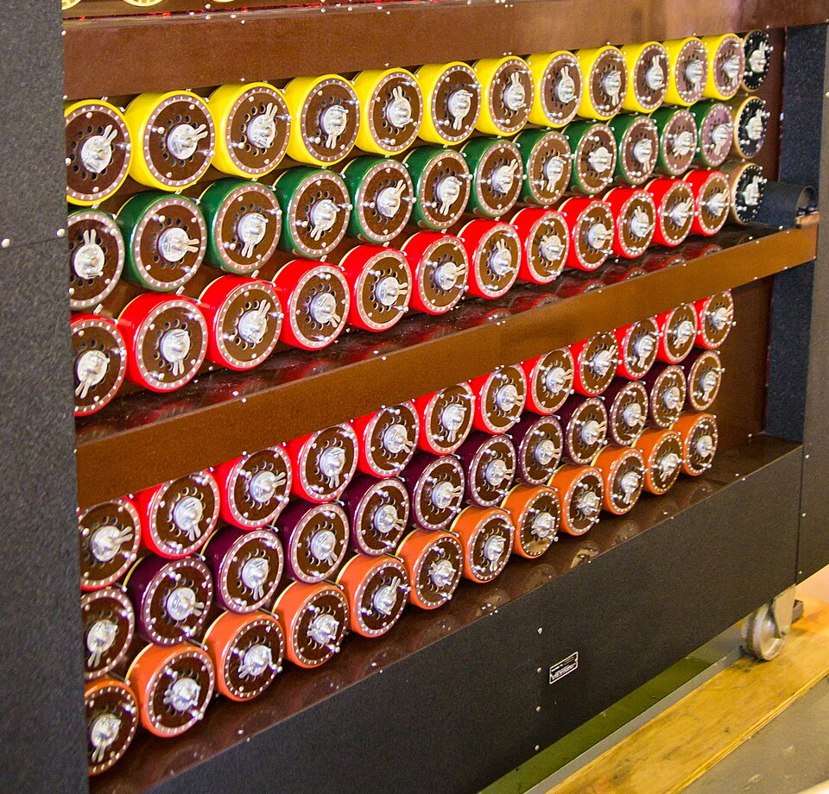
Bombe – Electromechanical Iteration
During World War II, the Germans used a device called "Enigma" to encrypt messages and send them using morse code and radios
The Bombe was a British device that tried repeatedly to guess the Enigma settings for the day (like a "password")
https://en.wikipedia.org/wiki/Bombe

Slide 34
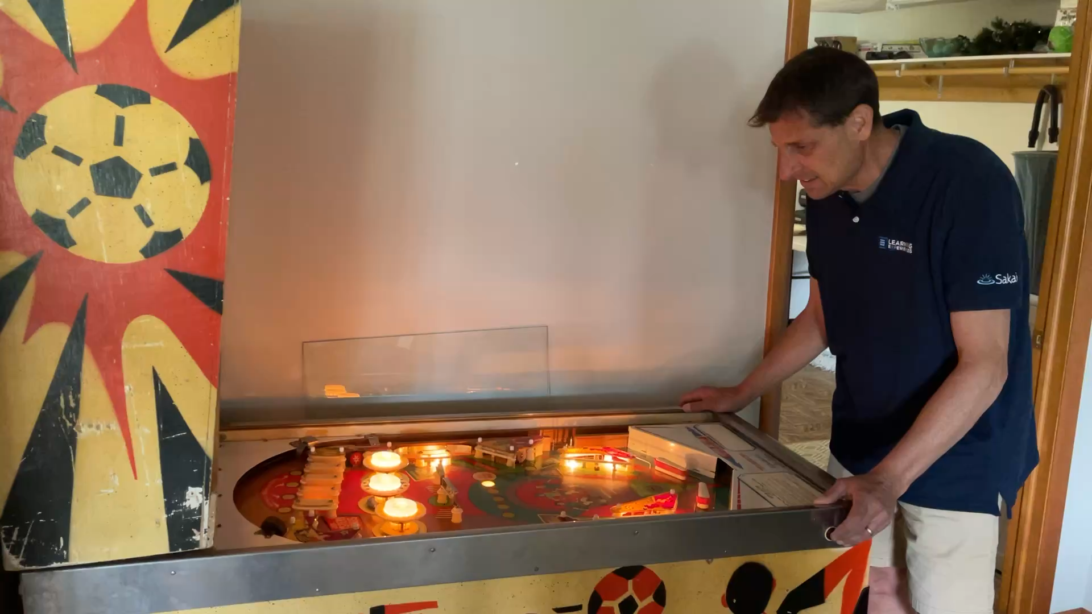
Pinball Machine – Electromechanical
A Pinball machine uses switches, relays, and physical storage to keep track of a game score, award specials, count the number of balls, take money, start and stop games
It requires careful attention to the timing of signals and devices
It is very much like a simple Bombe in terms of the technology used

Slide 35
Electronic Computers

Slide 36
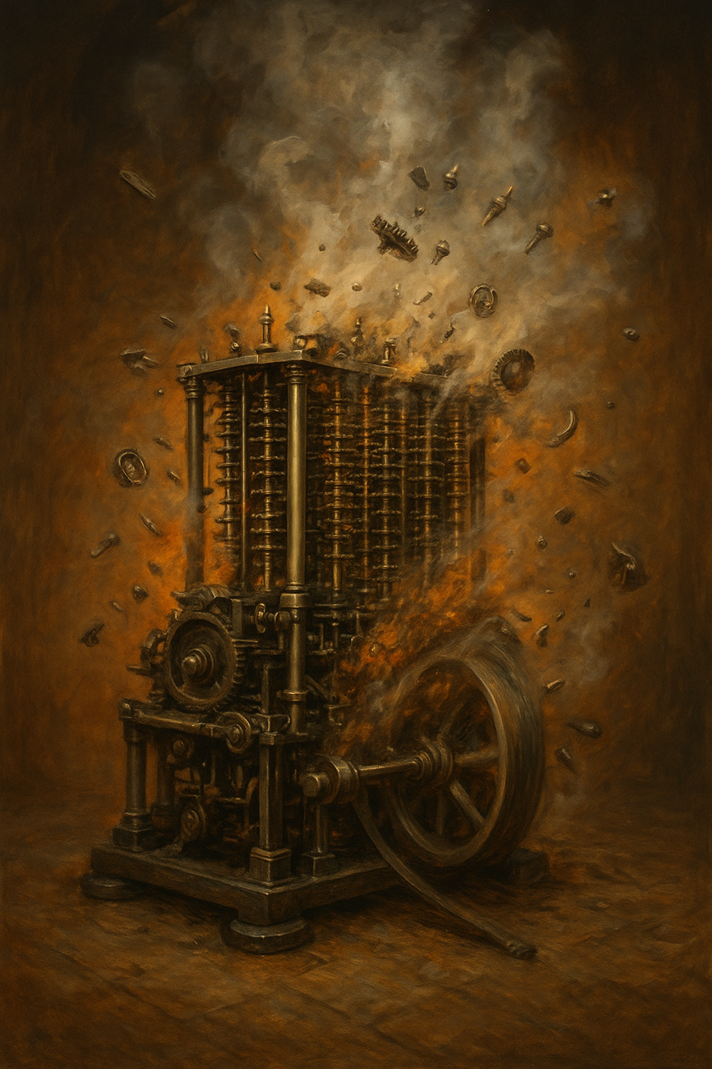
Colossus – Moving toward pure electronic
Up to this point, when there is a numeric value, we are changing like the "current time" or the "total points" we must physically change the value.
"Latch", "Click", etc..
This takes time, power, and generates friction / heat / wear
The speed of computation is physically limited so as not to damage the machine
ChatGPT: A Babbage Difference Engine overheating and starting to fall apart because it is running too fast.

Slide 37
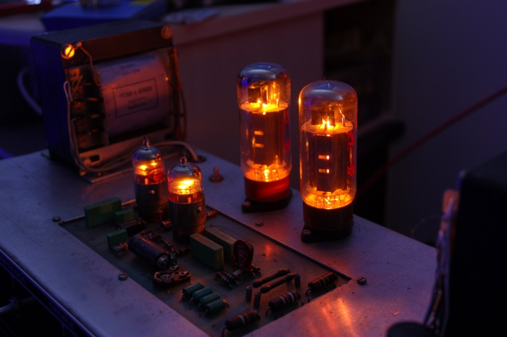
Electronic Switching using Tubes
An electronic "tube" or "valve" takes an input signal and power connection and produces a "louder" / "amplified" version of the signal
Tubes are analog and continuous but with a little more electronics they can be "digital" and latch in and maintain a "zero" or "one" value
Tubes take power and generate heat, but have no moving parts so they can switch faster than physical "latches"
https://en.wikipedia.org/wiki/Vacuum_tube

Slide 38
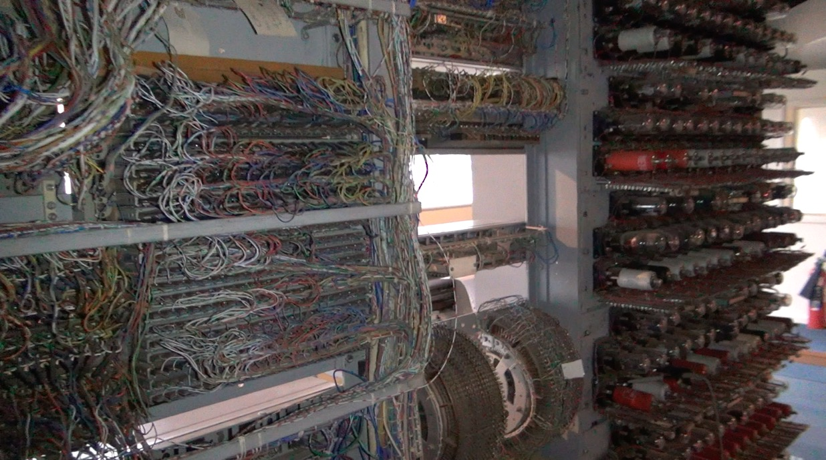
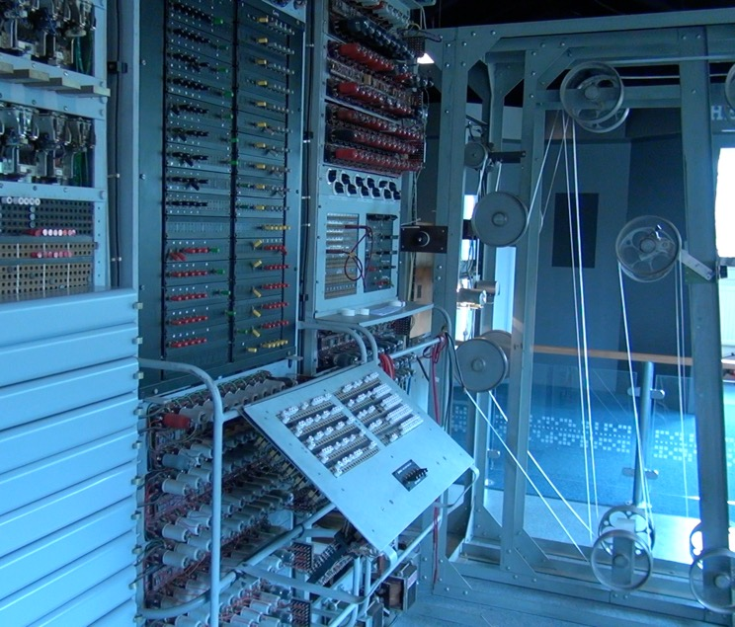
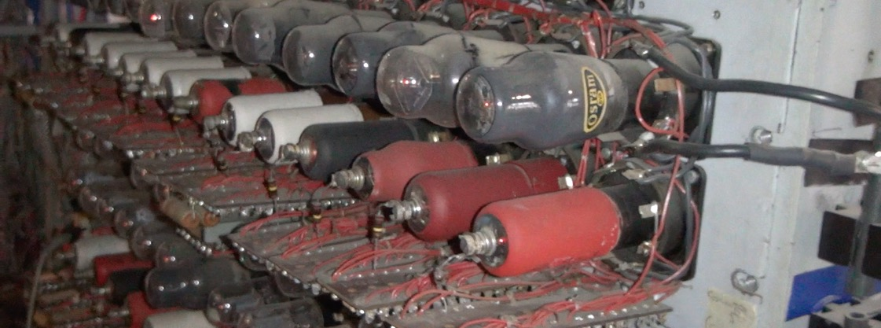
Colossus
By using tubes, Colossus could do addition and other computations much faster than the Bombe.
Power consumption and heat dissipation are still a challenge.

Slide 39
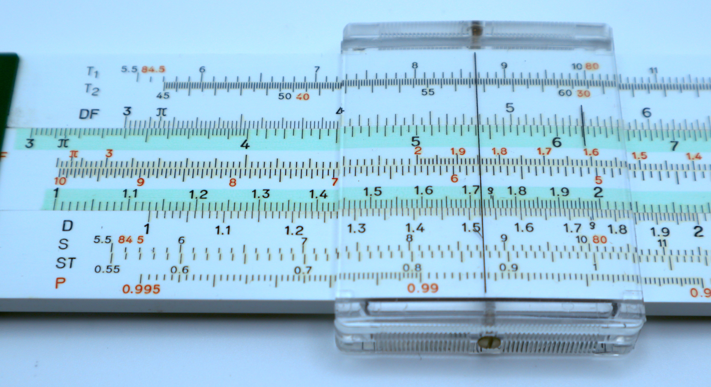
Hidden Figures - Programming
A subplot within the Hidden Figures (2016) movie is the transition from doing complex calculations manually to writing programs using FORTRAN on an IBM 7090
There was a natural parallel between following instructions precisely and precisely defining the instructions that a computer would follow
Being a human computer was a natural training ground for the emerging programming field
SUM = 0
DO 10 I = 1, 10 SUM = SUM + I 10 CONTINUE

Slide 40
Summary
Humans have built endless physical devices over time to help us better understand things like
Astronomy
The passage of time
Navigation through moving mediums (airplane / boat)
Accounting / money
Curved motion under the effect of gravity (space craft)
The IBM 7090 in Hidden Figures was built using transistors – solid state electronics that greatly reduced heat and power consumption and increased speed (40,000 multiplications per second)

Slide 41
Acknowledgements / Contributions
These slides are Copyright 2025- Charles R. Severance (online.dr-chuck.com) as part of www.ca4e.com and made available under a Creative Commons Attribution 4.0 License. Please maintain this last slide in all copies of the document to comply with the attribution requirements of the license. If you make a change, feel free to add your name and organization to the list of contributors on this page as you republish the materials.
Initial Development: Charles Severance, University of Michigan School of Information
Insert new Contributors and Translators here including names and dates
Continue new Contributors and Translators here

